Slide 1

FE 620 - Pricing and Hedging
American Option Pricing Model using Binomial Trees for GOOG Stock
Aidana Bekboeva, Rachel Besecker, Meher Kohli, Eden Luvishis

Slide 2
Table of Contents
Pricing Algorithm
Black Scholes Comparison
Sensitivity Testing
Data Analysis
Analyzing GOOG returns and volatility
Estimating Historical Volatility
Risk Free Rate
Modeling with Realistic Financial Data
Hedging analysis
Next steps

Slide 3
Introduction
We chose American options on GOOG
can be exercised at any time before expiration
underlying asset has high trading volumes,
option pricing more efficient
lacks dividends
easy to trade options (on CBOE, ISE or OTC with dealers)
Pricing American option
using binomial tree approach
call option price expected to converge to Black Scholes equivalent

Slide 4
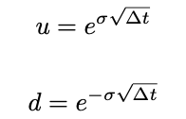
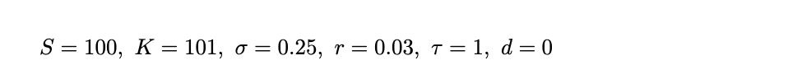
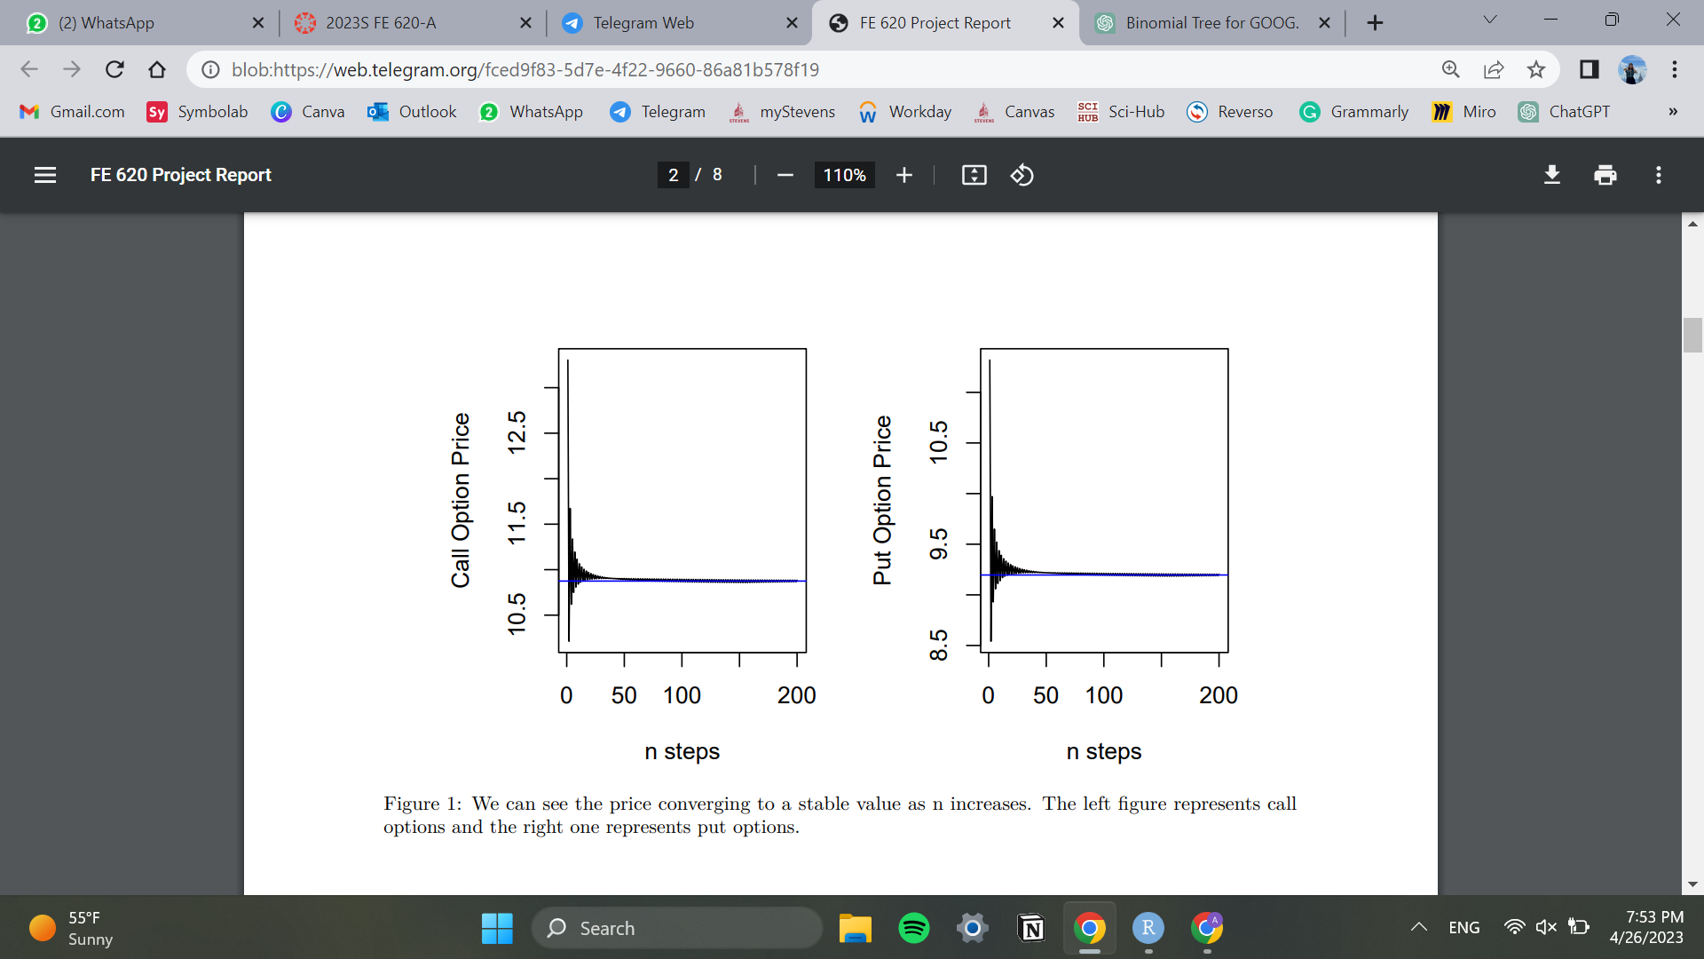
Pricing Algorithm with Generated Data
Black Scholes Comparison
Binomial Tree Comparison
Parameters:
Euro call = 10.87
expect option value to decrease as time passes
n = 200

Slide 5
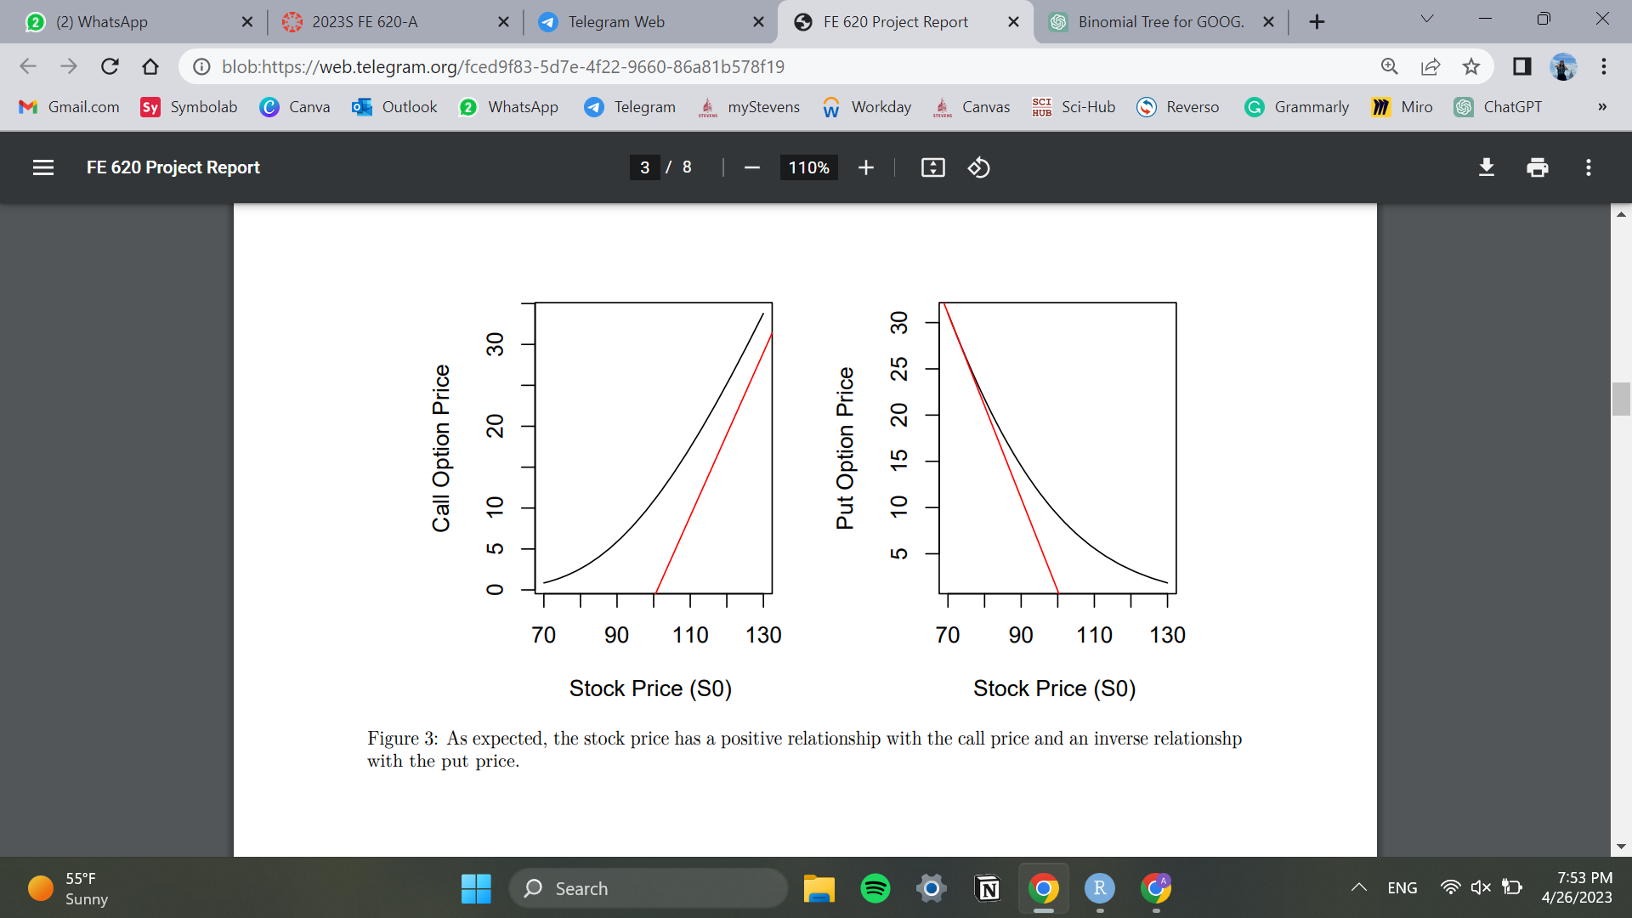

Pricing Algorithm. Sensitivity Testing
test for range K in [60,130]
K is inversely proportional to call price
K is positively proportional to put price
S0 is inversely proportional to put price
S0 positively proportional to call price
‹#›

Slide 6
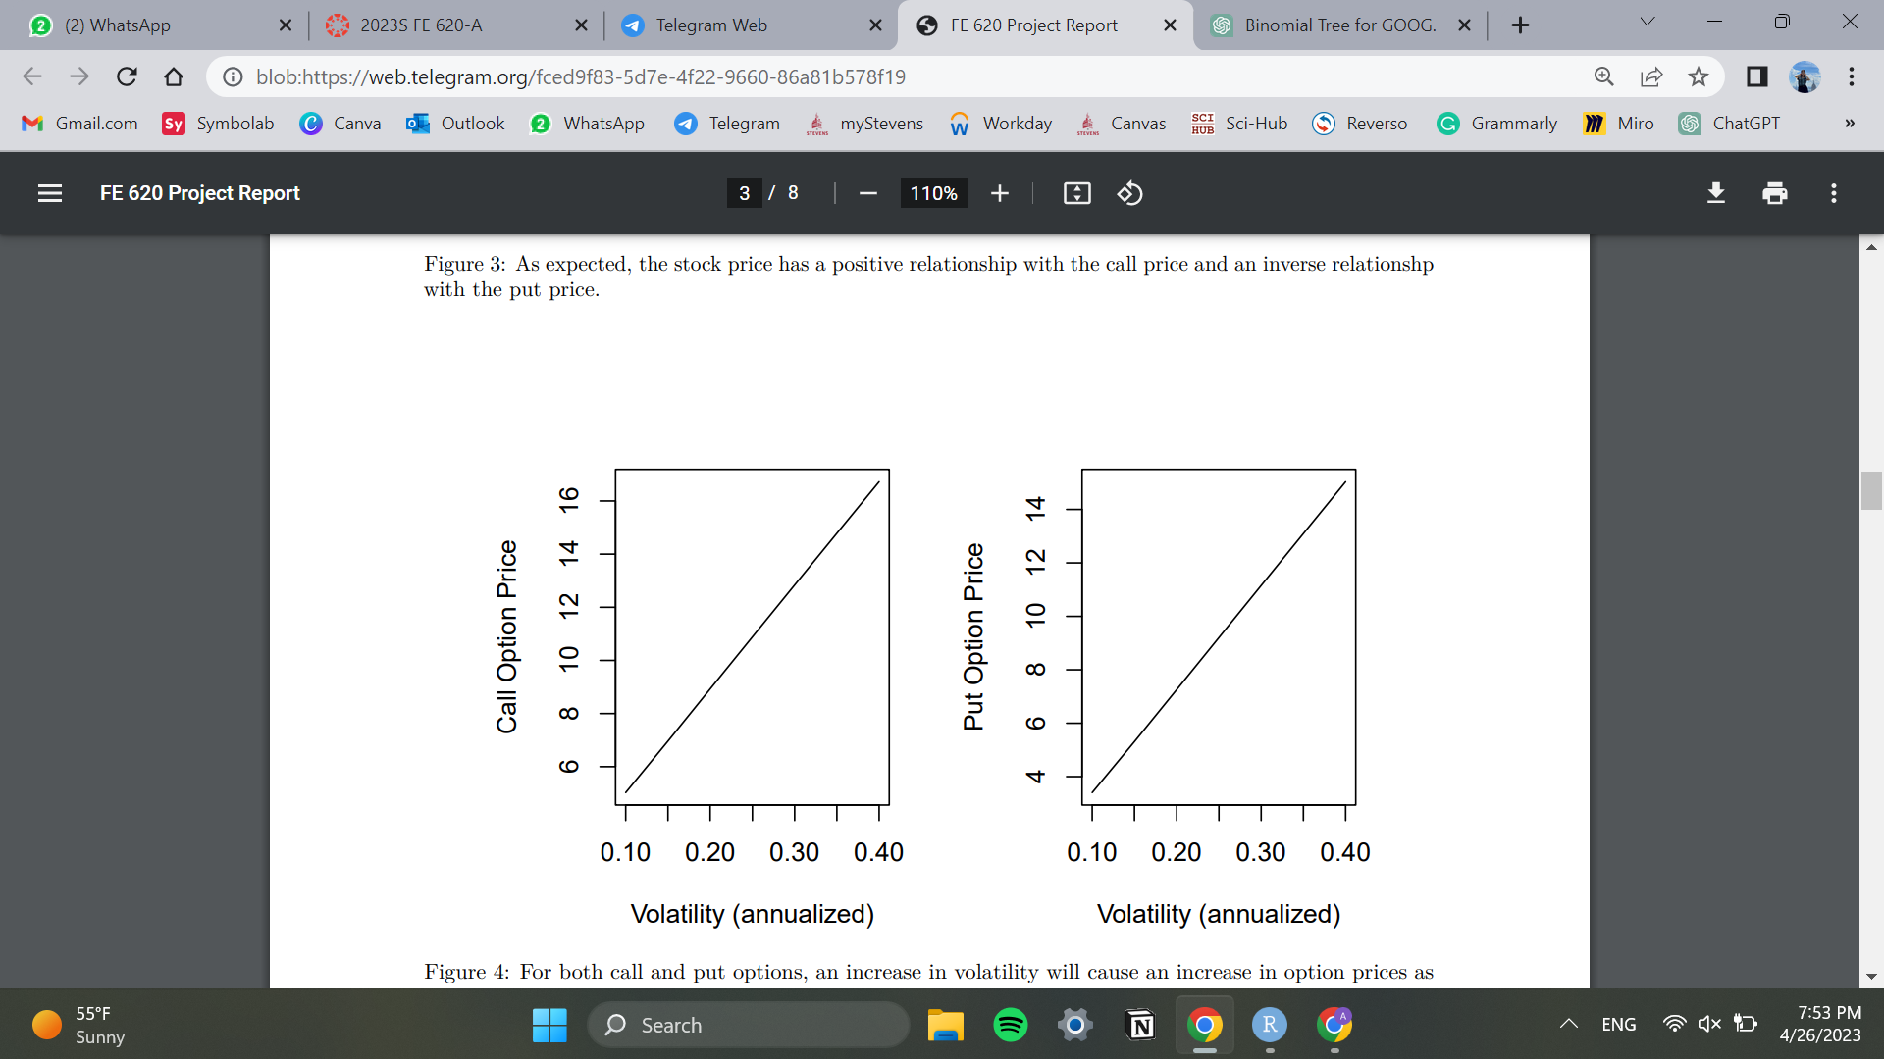
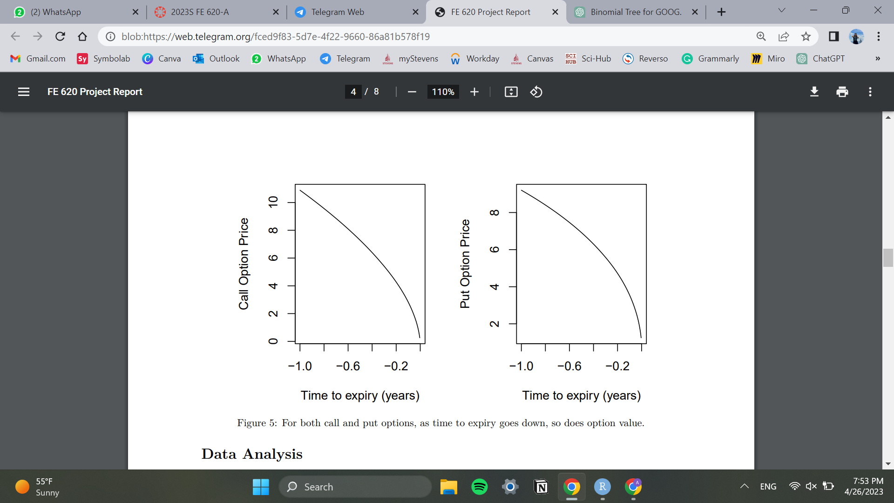
Pricing Algorithm. Sensitivity Testing
as volatility increases, both option prices increase
as time to expiry decreases, both option prices decrease

Slide 7
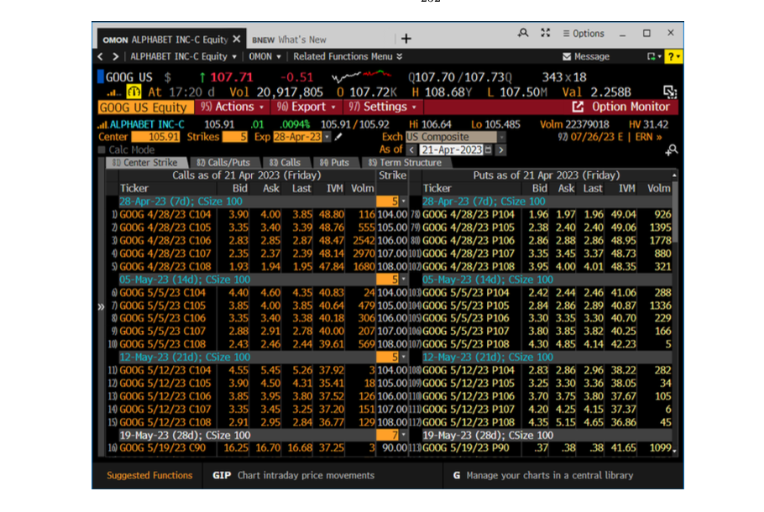
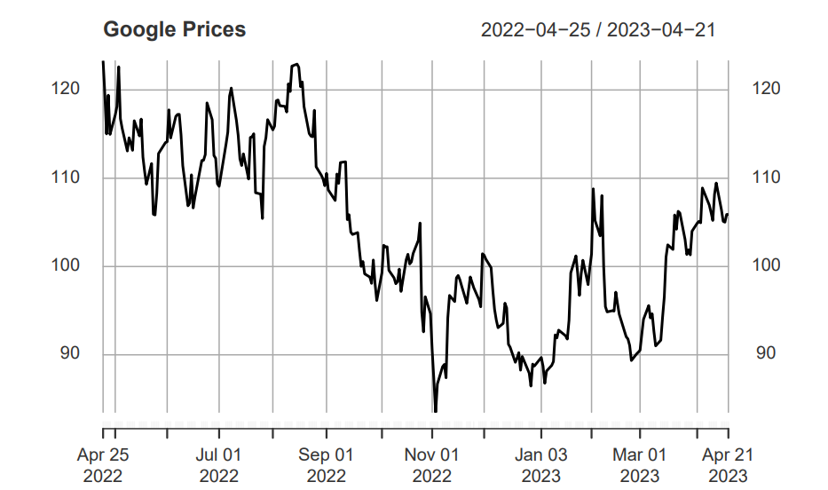
GOOG returns and volatility
Applying the model to real data:

Slide 8

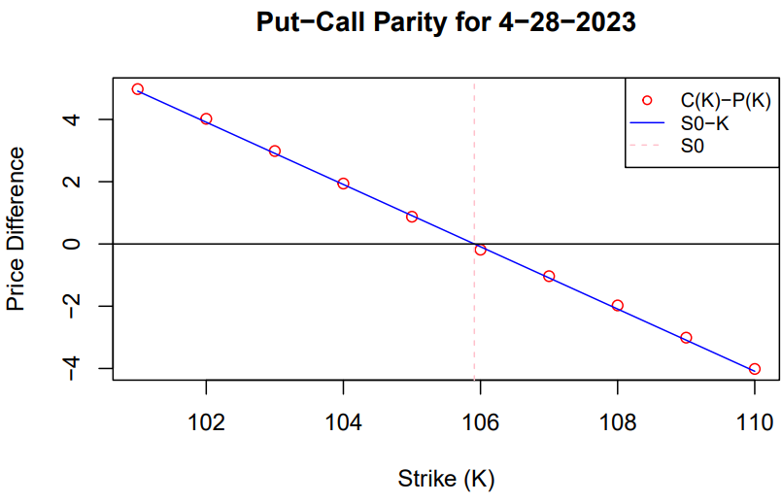
GOOG returns and volatility
study pricing for American options starting 04-23-23
expiry 04-28 (T = 5/252) and 05-03 (T = 10/252)
American options follow put call parity:
converges closely with

Slide 9
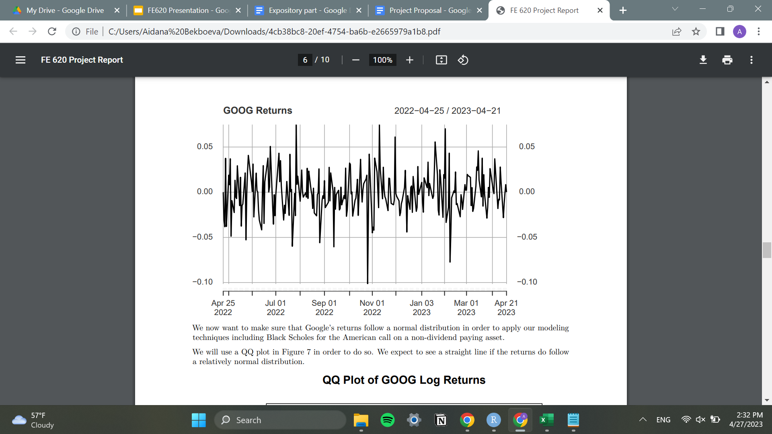
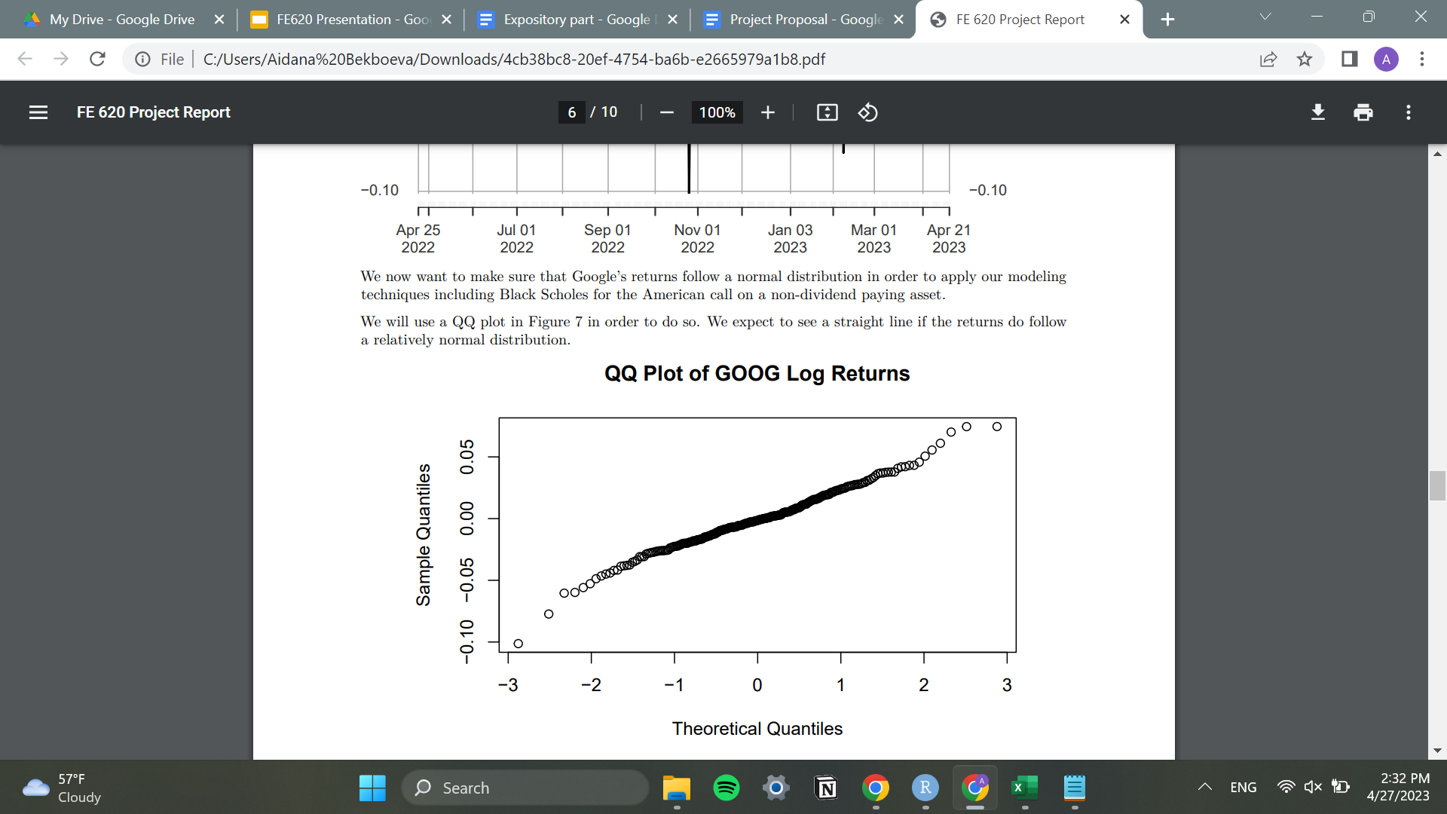
GOOG returns and volatility
We now want to make sure that Google’s returns follow a normal distribution in order to test against the Black Scholes model
log - returns graph for past year of data
The relatively straight line implies close to normal returns

Slide 10
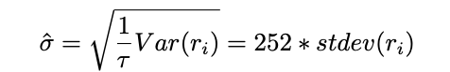
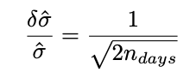
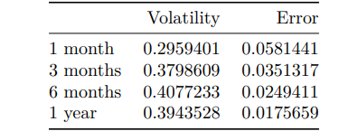
Estimating historical volatility
historical volatility:
error:
1 and 3 month have most accurate vol
3 month has a lower error estimate

Slide 11
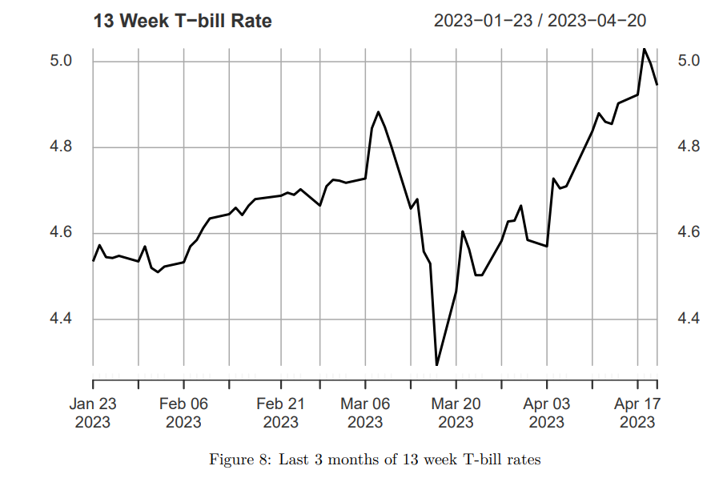
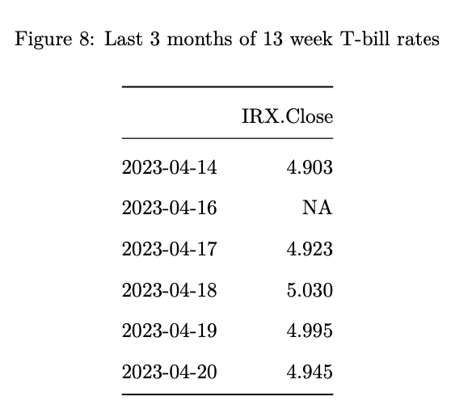
Risk Free Rate
We will use the most recent value r = 0.04945 as our risk-free rate estimate.

Slide 12

Modeling with Realistic Financial Data
n = 200 steps, as we can expect the price to converge by then

Slide 13
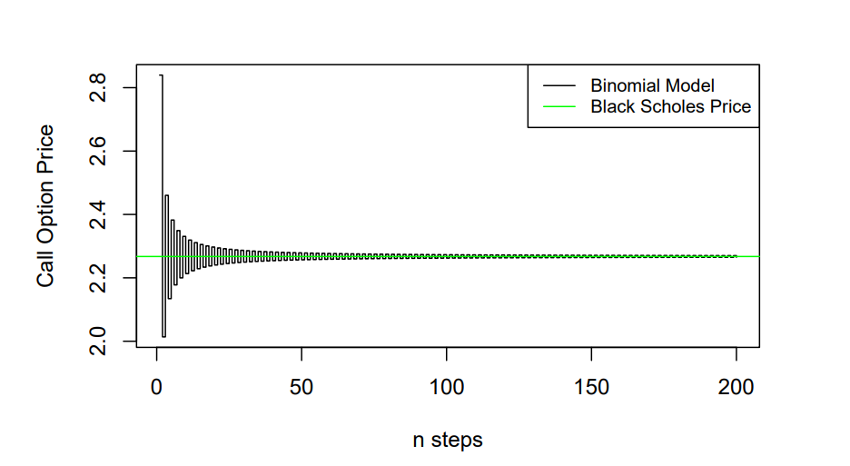
Modeling with Realistic Financial Data
We can conclude that the binomial model does in fact converge to the Black Scholes price for large n.

Slide 14
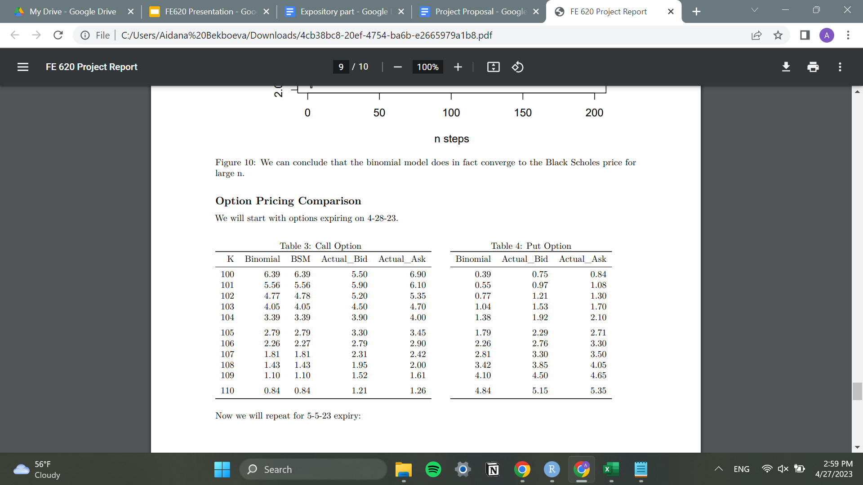
Option Pricing Comparison
Options expiring 04-28-23:
binomial model prices options with strikes close to S0 at lower values than the market does.

Slide 15
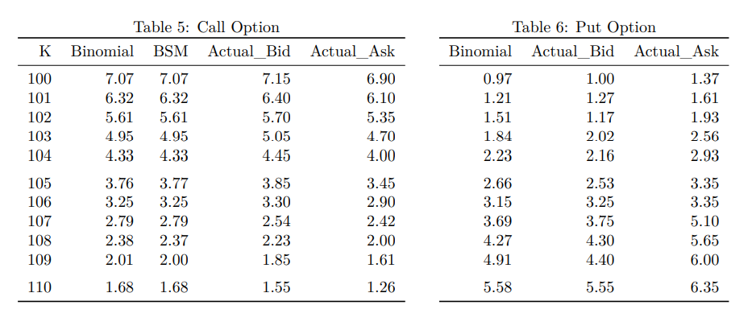
Option Pricing Comparison
Options expiring 05-05-23:
binomial model prices options with strikes close to S0 at lower values than the market does due to implied volatility

Slide 16
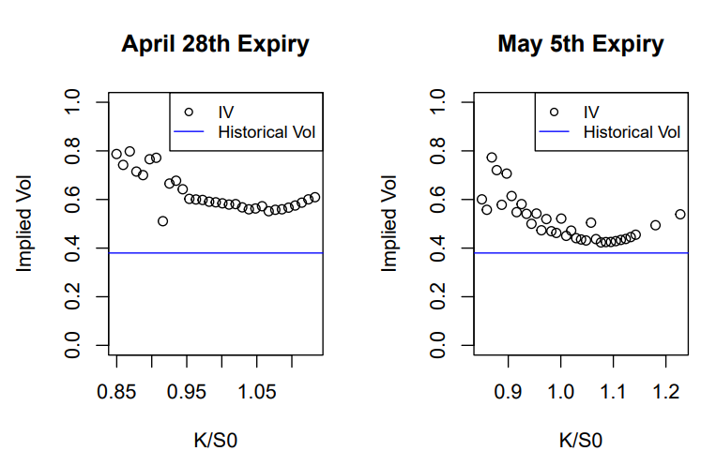
Implied Volatility
implied volatility is higher than the historical volatility (risk aversion)
no clear volatility smile observed
may 5 has partial smile

Slide 17
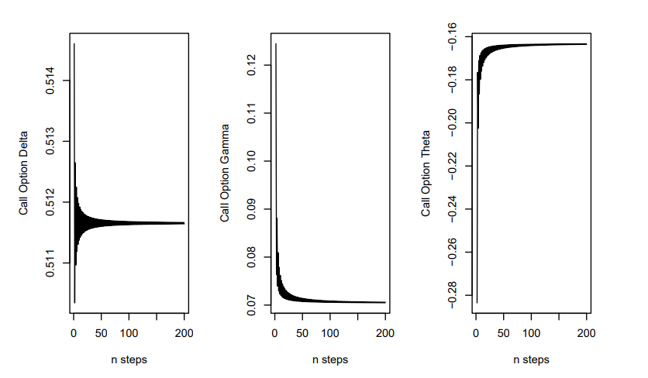
Hedging Analysis
Greeks of the call option on GOOG as of April 21st, 2023 with 5 days remaining until expiry.

Slide 18
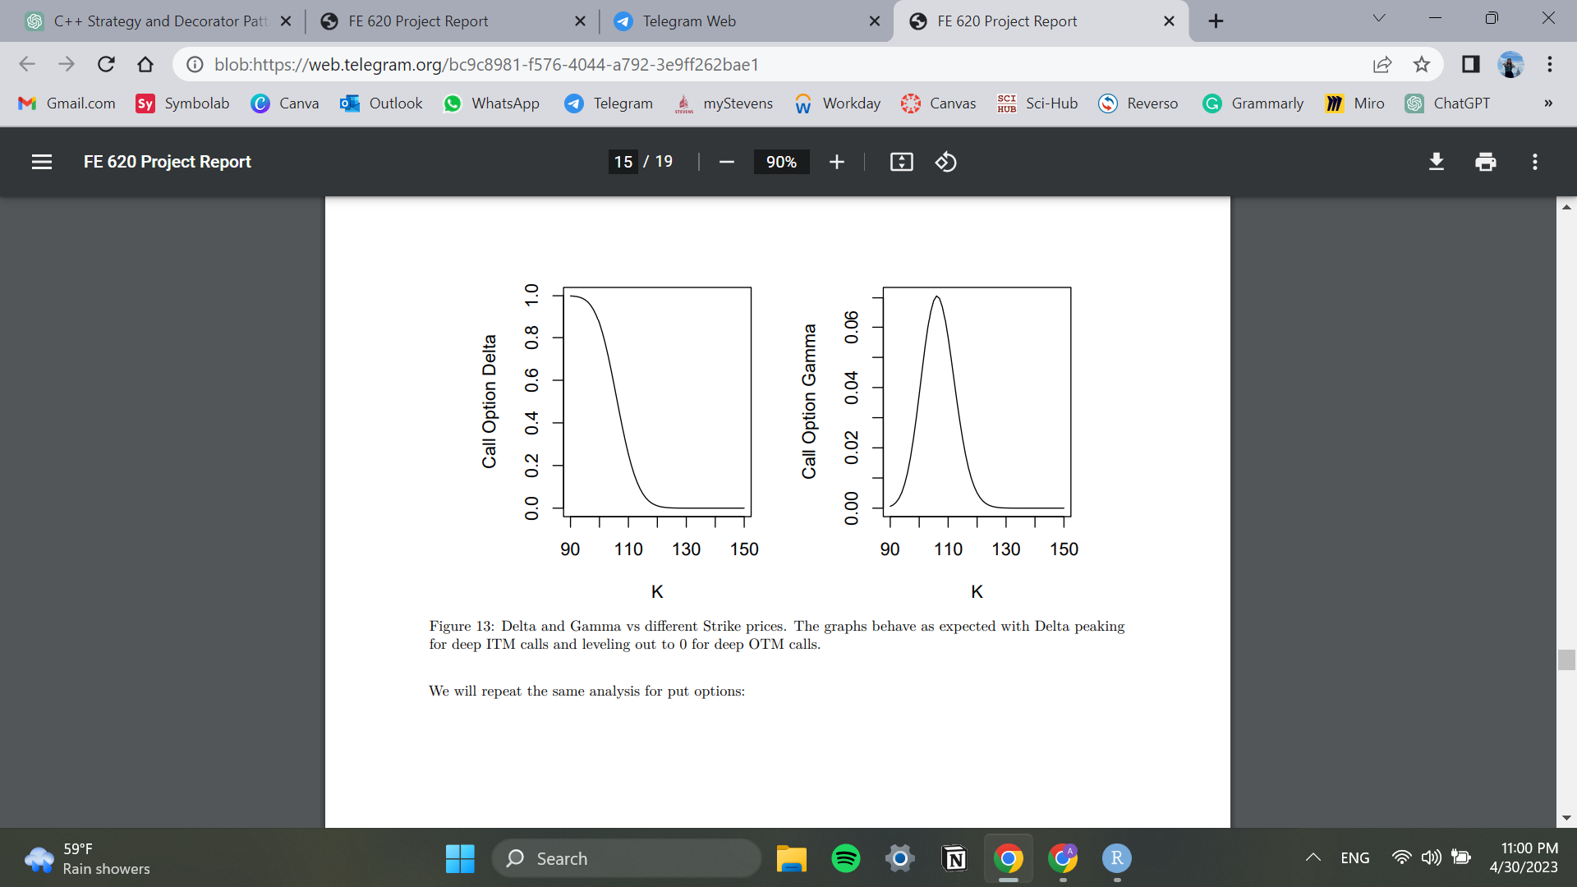
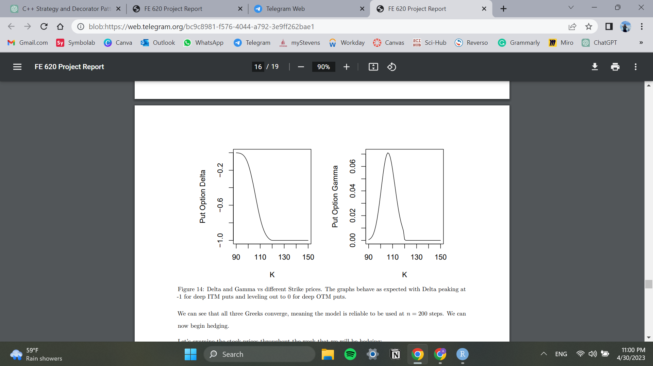
Delta and Gamma for different strike prices
Calls:
delta peaks at 1 for deep ITM calls and levels to 0 for deep OTM calls
gamma peaks at 0.065 for ATM
Puts:
delta peaks at -1 for deep ITM puts and levels to 0 for deep OTM puts
gamma peaks at 0.065 for ATM

Slide 19
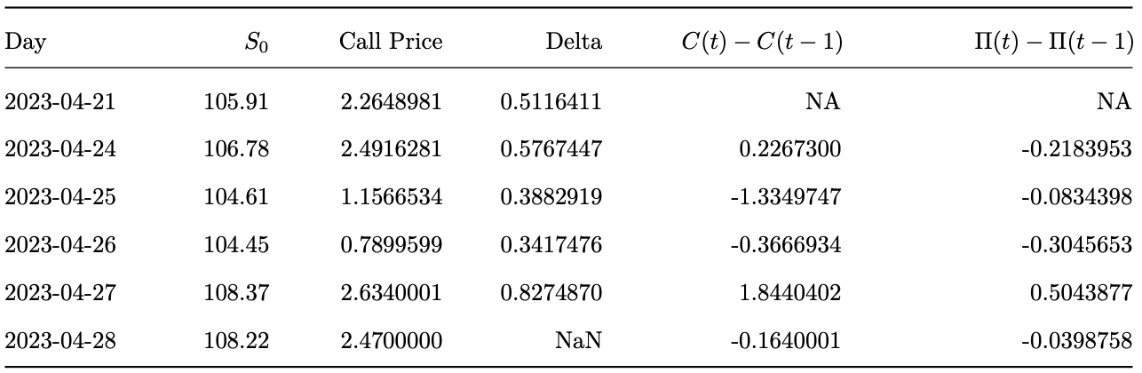
Hedging
Expected portfolio: Π(t) − Π(t − 1) = C(t) − C(t − 1) − ∆(t − 1)(S(t) − S(t − 1))
Hedging by shorting assets to negate the positive delta of call options
The portfolio has consistently lower variance than the call option by itself
Gamma and Theta effects can cause slight price variation

Slide 20
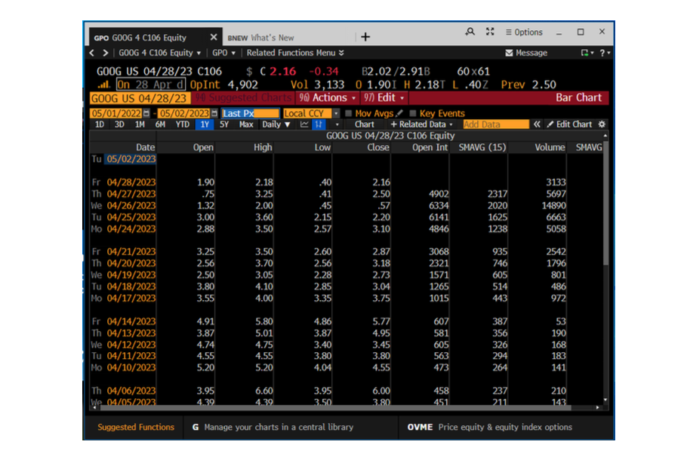
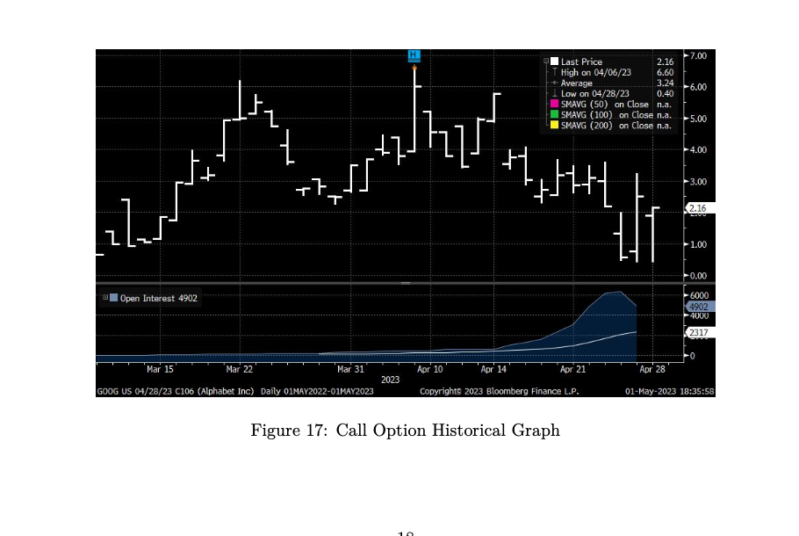
Hedging
Bloomberg data on option prices
We used Close data for each day in our models

Slide 21
Next Steps
Incorporating dividends
GOOG does not pay a dividend
Incorporating dividends into the pricing model could provide a more accurate estimate of option values
Expanding sensitivity testing
We tested the sensitivity of option values to changes in 𝖪, S0 , 𝜎, and 𝜏
Test the impact of interest rates or changes in market conditions on option values
Real-world testing
Use historical market data to provide more accurate estimates of option values.
Can help to identify any potential weaknesses or limitations in the pricing model.
Consider other asset classes
Value bonds or other fixed-income securities
Estimate the value of assets in other industries (ex: real estate, energy, etc.)

Slide 22
References
[1] https://www.theoptionsguide.com/volatility-smile.aspx
[2] John C. Hull, Options, Futures and Other Derivatives, Pearson, 10th Edition, 2018
[3] Bloomberg Finance L.P
[4] Yahoo Finance

